Slide 1
COVID-19 Prediction by Big Data
Team #1 Chong Fan & Shuyan Wang

Slide 2





Slide 3
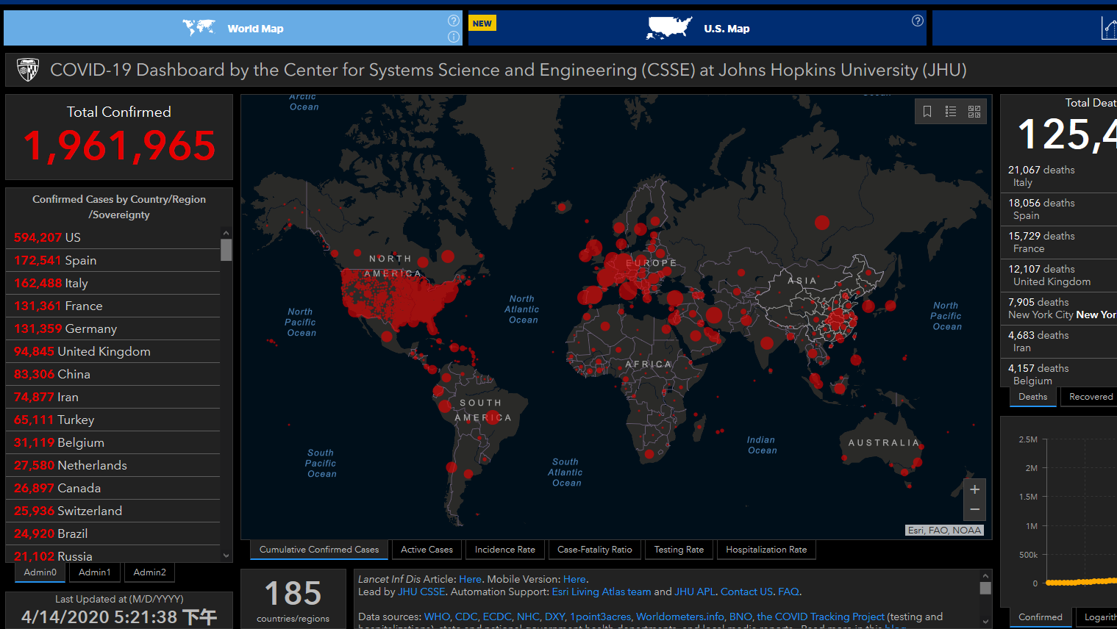
What does the data means?
How about the future?
How to deal with the situation?

Slide 4
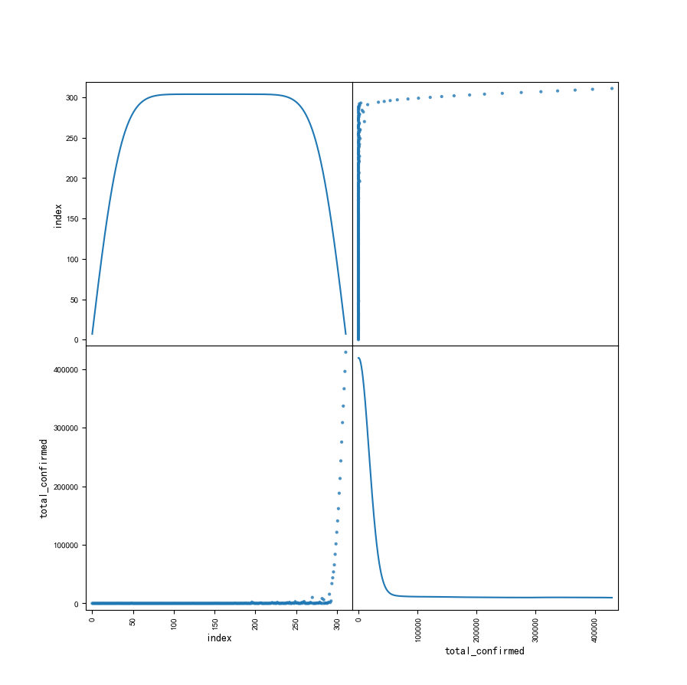
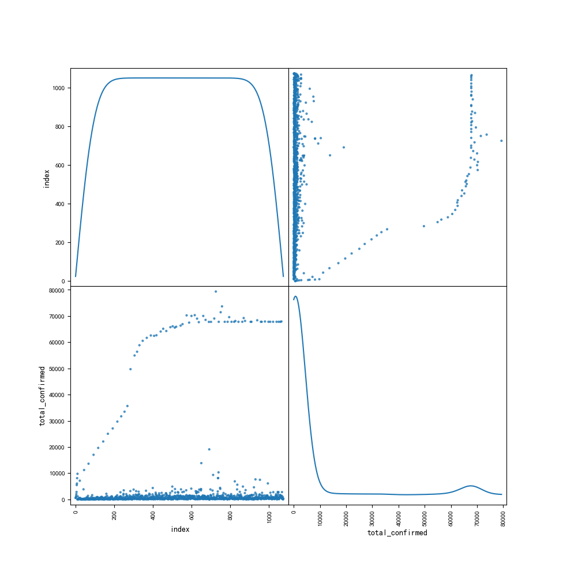
China
US

Slide 5
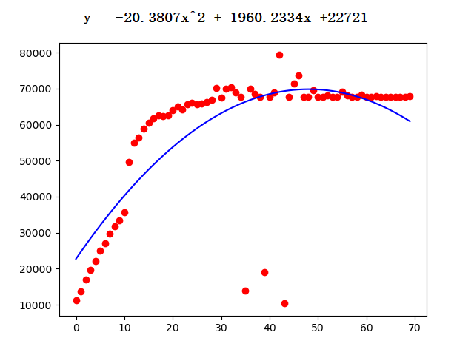
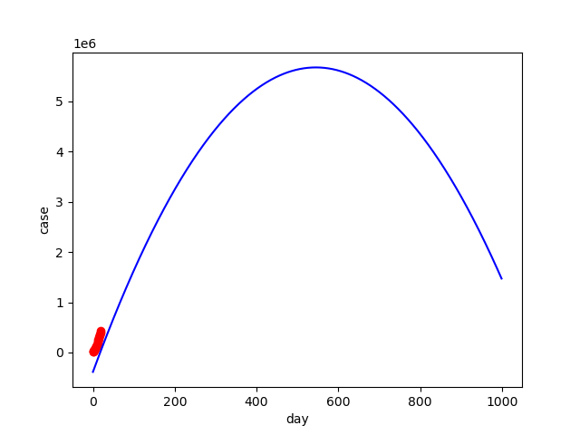
China
US

Slide 6
Acceptance
Criteria
Expected | Achieved
Root mean squared error is less than 60% confirmed case. | Root mean squared error is 37399, 6% of confirmed case.
Queries can be performed in 0.5 second. | Queries is performed in 24 milliseconds.

Slide 7
 | April 08 | 09 | 10 | 11 | 12 | 13 | 14
real | 429065 | 461437 | 496535 | 526396 | 555313 | 580619 | 607670
predict | 429065 | 449689 | 470298 | 490867 | 511394 | 531881 | 552326
Even worse than prediction!
Correl = 0.998527420099333
R Square = 0.99705700869023
Calculation Methord Reference: https://www.youtube.com/watch?v=qGLikYK-SIU&feature=youtu.be

Slide 8
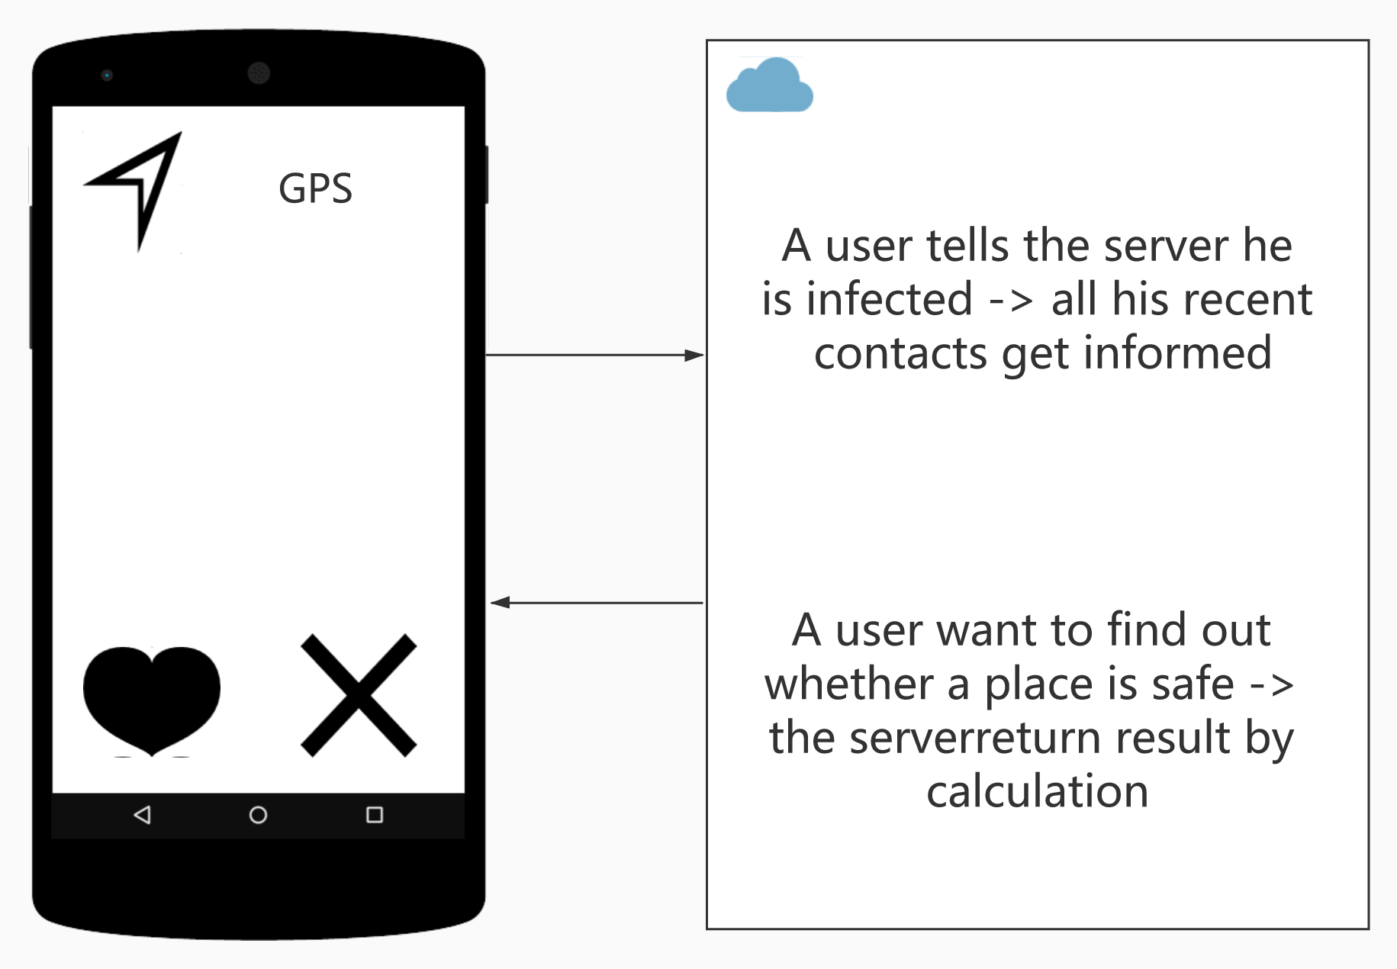

Slide 9
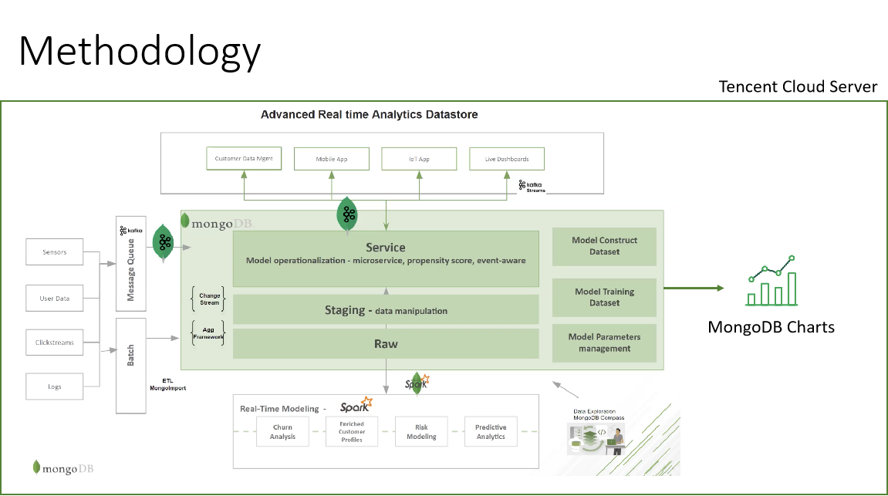

Slide 10
Demo

Slide 11
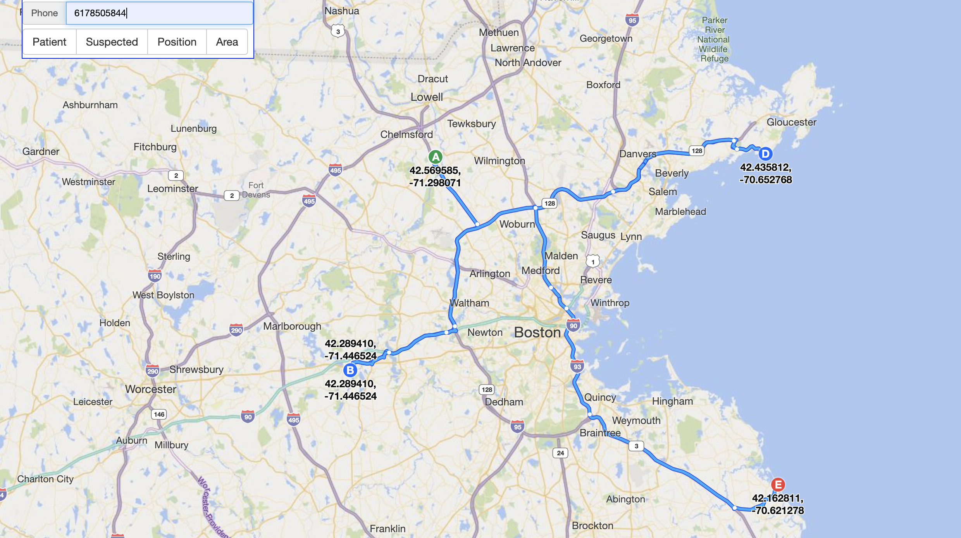

Slide 12
Thank you!

